Slide 1

The Construction Dust Partnership
What you need to know about dust
Notes:
The following presentation has been developed to give those attended and good basic knowledge of what dust is and how our body responds to it.
The presenter should take time to understand the progression of the slides and be fully converse with the speakers notes on each slide.
A practiced and experienced speaker on the subject should take approximately 45 minutes to an hour to complete the presentation.

Slide 2

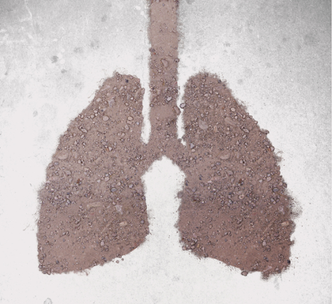
The Construction Dust Partnership
What is dust?
Notes:
Dust is often the forgotten chemical exposure. Its not something that you will get have a safety data sheet for, or will come labelled with hazard symbols.
It is for this reason that it is important that employers and employees make sure they are aware of what are the health implications of what they breath in.
This training presentation has been put together to help those working in construction make the correct decisions on how to control their dust exposures, as well as understand the reasoning behind why you need to control these exposures.

Slide 3
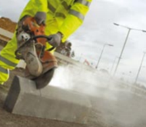
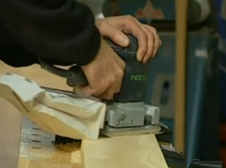
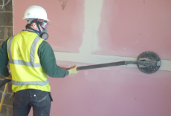
What is DUST ?
Dust consists of particles broken up from solid materials
Exposures to dusts are the 2nd biggest killer in the construction industry
In construction dusts are typically;
  Sand & concrete
  Wood – including MDF
  General dusts/Gypsum – Plasterboard
Notes:
Everyone should be able to understand what dust actually is. The problem comes when trying to understand what dust can do to you.
The key to understanding this is to understand what is inside the dust, as different chemicals and different materials have different effects. A simple example would be that of asbestos. Most would be able to appreciate that asbestos dust is going to have a greater effect than that for dusts from cutting wood.
Everyone needs to have a greater appreciation of what health effects dust can have and because of the wide range of materials used in construction it can be difficult to separate out what different dusts can do. For this reason it is considered easier to concentrate on three broad categories;
1 – Sand, Stone, Concrete and Stone products
2 – Wood, and all wood products (such as chipboard and MDF)
3 – Other general dusts, including Plasterboard.
Being aware of the potential health effects of these three hazardous compounds will be a good starting point to appreciate how different dusts can effect you, and what you might need to do about it.
To give an example of how complicated it can be – the hazards of wood dust can be differentiated between different species of tree. It is for this reason that we apply these broad categories, and perhaps also mention the differences between softwood and hardwood.

Slide 4
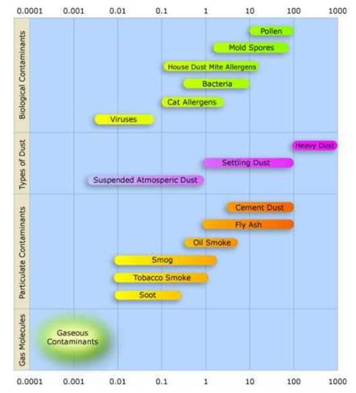
What is DUST?
Dust is best defined by its size. The size of dust determines how your body can protect itself against it
Larger dust is called inhalable dust. These can generally been seen by the naked eye
Smaller dust is called respirable dust. This dust can be invisible to the naked eye
"Airborne-particulate-size-chart" by Jisaac9 (Own work) - Licensed under Creative Commons Attribution 3.0 via Wikimedia Commons
Notes:
The size of dusts has a relationship with the potential ill health effects that may occur. It is important to appreciate the dust comes in difference sizes, and that size dictates where the dust ends up inside the lungs.
The diagram represents the different sizes of various dusts. On this diagram respirable dusts are anything that is below 10(micrometers)
Generally speaking the larger inhalable fractions of dusts can be removed by the lungs defensive mechanisms; namely sneezing and the mucociliary escalator (coughing up of mucus and trapped dusts from the lungs)
Respirable dusts get to the deep lung where the mucociliary escalator is not effective. This requires the immune system to break down the material caught in the lungs. If the immune system cannot remove the dust then it remains trapped in the lungs where it will have long term chronic effects.

Slide 5
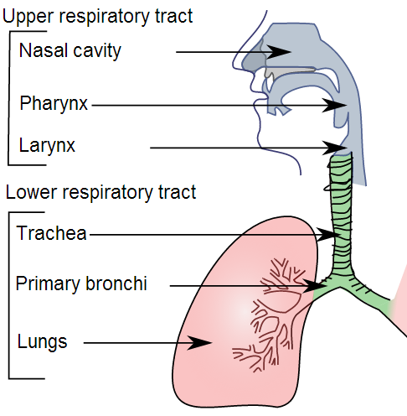
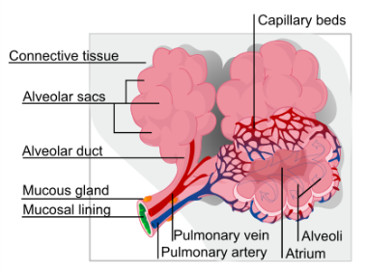
How does dust get into the lungs?
Dust can enter your lungs via your nose or mouth, into the trachea and via bonchi ultimately reaching alveoli.
"Illu conducting passages" by Lord Akryl - http://cancer.gov. Licensed under Public domain via Wikimedia Commons
"Alveolus diagram" by LadyofHats - self-made(extracted from Image:Respiratory system complete.svg) Licensed under Public domain via Wikimedia Commons
Notes:
Before understanding how the lungs can be effected it is important to understand how dust can enter the lungs. This slide should give a basic outline of how air enters the lungs, and obviously where air can go the dust can be transported with it.
Whilst the respiratory system can be seen as fairly complicated, it is easiest to summarise it as follows
Nose – the primary route of air (and therefore dusts) into the body
Sinuses – Large air spaces which slow and warm air before entering the lungs
Mouth – the secondary route for air entering the body (bypassing the sinuses)
Windpipe – The trachea, which branches in to two bronchi, which in turn branch in to bronchioles
Alveoli – Air sacs, collected in groups at the end of the lungs. This is where air ultimately reaches and is where oxygen is transferred into the blood supply.
It might help at this stage to describe the lungs as an inverted tree. The main trunk is the windpipe, which branches into every smaller tubes – ultimately ending in twigs and leaves. In trees you have leaves at the end, in the lungs you have air sacs or balloons called alveoli. Any dust that is small enough to get to the air sacs will be trapped there.

Slide 6
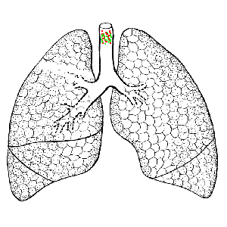
What is DUST?
Larger (Inhalable) dust
  These dusts can effect your upper lung (the nose, sinus, windpipe and bronchus)
Smaller (Respirable) dust
  These dusts are small enough to get into your bronchioles and the fragile alveoli.
Inhalable Dust
Respirable Dust
Notes:
This slide is primarily aimed to give a visual representation of how dusts reach different parts of the lung, and that these effect different parts of the body.
The size of dusts has a relationship with the potential ill health effects that may occur.
Generally speaking the larger inhalable fractions of dusts can be removed by the lungs defensive mechanisms; namely sneezing and the mucociliary escalator (coughing up of mucus and trapped dusts from the lungs)
Respirable dusts get to the deep lung where the mucociliary escalator is not effective. This requires the immune system to break down the material caught in the lungs. If the immune system cannot remove the dust then it remains trapped in the lungs where it will have long term chronic effects.
In describing the structure of the lungs the anology of an inverted tree helps – the main windpipe being the trunk which progressively branches to smaller twigs ending in leaves (representing the alveoli)

Slide 7
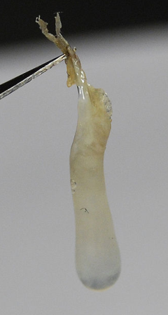
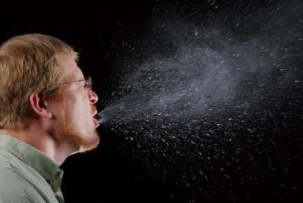
What is DUST ?
Nose:
Dust particles can get caught in your nasal cavity, leading to health problems such as nasal cancer from exposure to hardwood dusts.
Mouth:
Dusts in your mouth typically give a taste to the air – however these particles do not often give health problems as they are swallowed in small quantities
Dusts caught in the sinuses and nose are removed by sneezing
"Popel" by – Gohnarch, Licensed under Creative Commons Attribution-Share Alike 3.0 via Wikimedia Commons
Notes:
This slide addresses the first two points of where dusts can get trapped prior to entering the lungs.
Nose – this has a large amount of hair and mucus lining it. The hair and sinus is there to physically trap dusts, to slow the air, and to change the direction of air so that any dusts can get trapped in mucus lining. Mucus plays a major role in protecting the lungs. Dust trapped in mucus lining the sinuses and nose is removed by sneezing or physically blowing your nose.
Mouth – The taste that dusts give to the air shows the hazard of ingestion of toxic materials. This may be an issue in high risk environments such as contaminated sites where some contaminants may have serious health implications.
The natural lighter colour of mucus can be seen at the bottom of the picture to the right. As contaminants get caught in the mucus it discolours and dries out, as seen at the top of the picture.

Slide 8

What is DUST ?
Upper Lung:
Larger dust particles in the upper respiratory tract get caught in mucus lining the lungs
This mucus is transported up to the mouth to be coughed out
This is why snot and phlegm are often discoloured after exposure to dusts – it is a visual indication that your immune system is working
"2013 Woodstock 127 fala, crowd surfing" by Ralf Lotys (Sicherlich) - Own work. Licensed under Creative Commons Attribution 3.0 via Wikimedia Commons
Notes:
Dusts that get past your nose, sinus and mouth can get into the upper lung – the larger air passages including the trachea (windpipe) and the bronchi
These passageways are lined with ‘hairs’ called cilia. These hairs are covered in a layer of mucus. It is this mucus that traps dusts. This dirty mucus is transported up to the top of the throat by rhythmic waving (about 20 times a second) of the hairs in a process called the mucociliary escalator. Mucus moves at 1mm a minute in smaller airways, 2cm a minute in larger airways until it gets to the top of the windpipe.
The principle of the mucociliary escalator can be likened to the practice of crowd surfing (hence the picture) – where the person doing the surfing is the particulate, and the crowd supporting them and moving them are the cilia
Once out of the windpipe and at the top of the throat this mucus can be coughed out as phlegm.

Slide 9
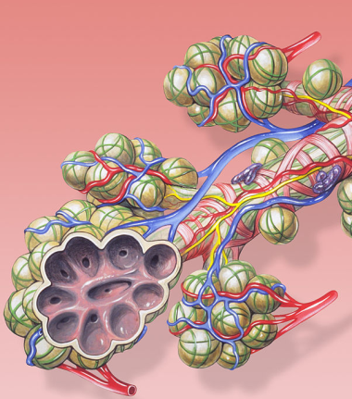
What is DUST ?
Lower Lung:
Only the finest dust particles get to the bottom of your lung
Once here they cannot be removed
They either;
  remain stuck in the lung
  are broken down by the immune system
  develop scar tissue causing pneumoconiosis diseases such as silicosis or asbestosis
  cause an allergic response which damages the lung
"Bronchial anatomy" by Patrick J. Lynch, medical illustrator - Patrick J. Lynch, medical illustrator. Licensed under Creative Commons Attribution 2.5 via Wikimedia Commons
Notes:
The lower lung is predominantly the alveoli (the air sacs or leaves in the tree analogy) at the end of the air ways in the lungs. There is no mucus or ‘hairs’ to remove the mucus and any dust that gets trapped inside.
Because the dust particles cannot be removed they will remain trapped inside the lung. The only way which these can be removed is by the immune system – specifically by the alveolar macrophages. These are immune cells designed to clear the surface of alveoli of particulates and bacteria by engulfing them
Often the immune cells cannot breakdown the dust and so they remain inside the immune cell until its eventual death. The dead cell may then instigate the formation of scar tissue in the alveoli, which can develop into pneumoconiosis.
The allergic response can occur on different grades, from mild discomfort (similar to hayfever) to extreme constriction of the airways requiring hospitalisation and provision of oxygen. When this happens we call this sensitisation – someone becoming sensitive to something.

Slide 10
The Construction Dust Partnership
What can it do to me?
Notes:
Having covered how dust can get inside our lungs, and how our lungs can defend themselves, the next thing to address is what happens when our defence doesn’t work.

Slide 11
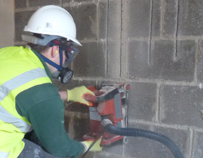
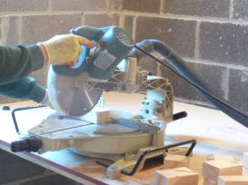
What can DUST do to me ?
Different dusts can have different effects
  Sand and Concrete
    Irreparable long term lung damage called Silicosis
  Wood
    Lung cancer and allergic reactions (sensitisation)
  Gypsum & General Dusts
    A clogging up of your lungs known as Chronic Obstructive Pulmonary Disease (COPD)
Notes:
Refering back to the start and the three broad categories we have separated the different types of dust into, we can do the same with the occupational diseases that may be encountered.
Again, these are generalisations, most notably COPD which is the most common lung disease and can occur as a result of exposures to any dust – not just gypsum and general dusts. Similarly lung cancer and sensitisation is not just reserved for exposure to wood dusts.
Silicosis, as it name suggests, requires exposure to the chemical silica. As such you will not develop this from exposure to wood (as wood has no silica in it).
It is important to note that all of these diseases are dependant on the individual being exposed. Not everyone will respond to a chemical or dust the same way – the unfortunate will develop the disease, and the fortunate might not. There is no way of knowing how you might respond until you get exposed, but by then it might be too late.

Slide 12
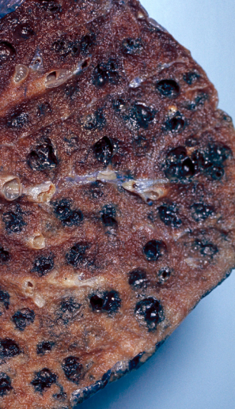
What can DUST do to me ?
Chronic Obstructive Pulmonary Disease
Lung damage and inflammation which restricts your airways
At its most basic it is a clogging up of your lungs with dust and other particulate
Dr. Edwin P. Ewing, Jr. - http://phil.cdc.gov/phil_images/20040517/4/865_lores.jpg
Notes:
COPD is an obstructive lung disease, the obstruction being the dust itself or the lungs becoming inflammed and restricting air passages.
Chronic Bronchitis is a type of COPD where the inflamamation occurs in the larger airways (the bronchi).
Emphysema is another type of COPD, where the walls of the alveoli (airsacs) break down, turning bunches of alveoli into one large alveoli (which reduces the available surface area for oxygen to be transported into the blood.
The picture is a typical lung from a smoker who has emphysema, the large single alveoli being identifiable as the black spots

Slide 13
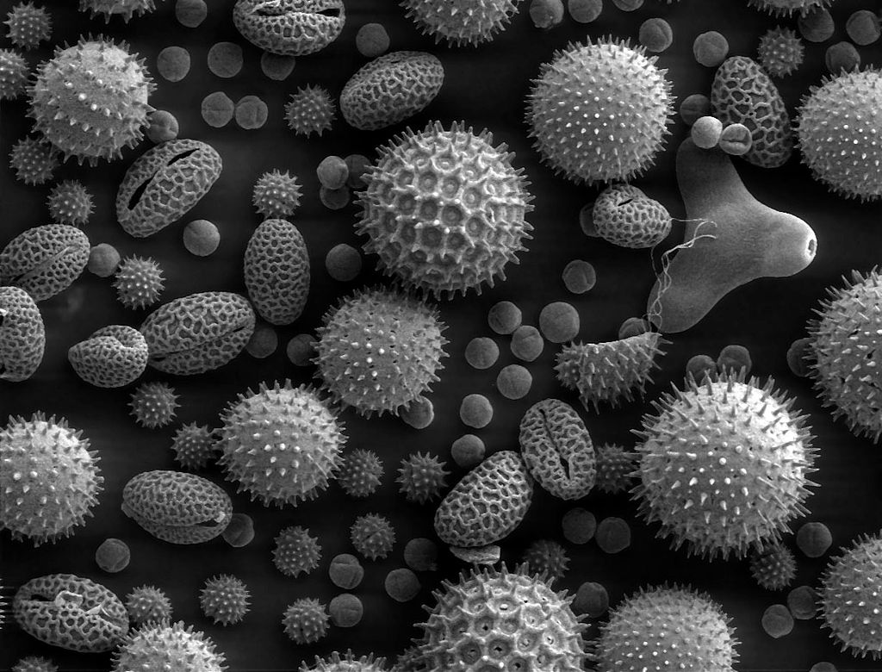
What can DUST do to me ?
Lung Sensitisation
An asthmatic reaction (breathlessness, wheezing, etc.) caused by an overreaction in the immune system following exposure to a sensitising dust.
Once sensitised, very low levels of exposure can lead to a life threatening asthma attack, the condition is retained for life and the sensitised individual may become susceptible to other sensitising and none sensitising agents
"Misc pollen" by Dartmouth Electron Microscope Facility, Dartmouth College. Licensed under Public domain via Wikimedia Commons -
Notes:
As mentioned before, sensitisation is when someone becomes sensitive to something. It is a response of the immune system. There are different levels of sensitisation (or hypersensitivity) but the principle of how it develops remains the system.
Sometimes the immune system responds to dust as if it is a bacteria or virus, causing symptoms like excess mucous production, excessive sneezing, coughing, swollen sinuses (as seen in the common cold). The symptoms we feel are the result of our immune system trying to fight an infection, we all would have suffered these if we have a cold. These symptoms are similar to someone who has hay fever. In this case their body is responding to pollen the same way that others respond to the cold virus. But not everyone responds to pollen the same way, those that get hay fever are sensitised to pollen, those they don’t, arent sensitised.
Sensitisation can develop early on in life, or after many years. However once the reaction has been developed it is maintained for life.
Sometimes hayfever suffers will find that they haven’t had symptoms for a number of seasons. This is not because they have been cured, but because the are not exposed to the same type of pollen as they were before (as the picture shows there are many different types of pollen)
Occupational sensitisation is a lot more serious than that experienced by hayfever sufferers. The sensitisation reaction to construction dusts is often more similar to a severe asthma attack which can result in hospitalisation. The severity of the symptoms can be such that it is impossible for the individual to return to their line of work.

Slide 14
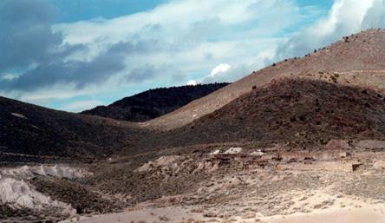
What can DUST do to me ?
Silcosis
Scarring and inflammation of your lungs
The more dust that is inhaled, the more the disease progresses
Full recovery is unlikely once the disease manifests itself
"Delamar". Via Wikipedia - http://en.wikipedia.org/wiki/File:Delamar.jpg#mediaviewer/File:Delamar.jpg
Notes:
Pneumoconiosis is a disease that is caused by different dusts. Depending on the dust causing it the disease is given different names, such as:
Coalworker's pneumoconiosis — coal
Asbestosis — asbestos
Silicosis — silica
Berylliosis — beryllium
Siderosis — iron
Byssinosis — cotton
Stannosis — tin oxide
All of these have similar symptoms and are diagnosed by taking an X-ray (to determine pneumoconiosis) and then a work history (to determine the likely cause).
Once fine silica gets inside of the alveoli the immune system tries to break it down. The immune system however cannot remove it and the cells die – imbedding themselves in the wall of the alveoli. This dead cell can initiate other cells to die around it, ultimately causing a mass of scar tissue inside the lungs. Through a process called calcification this scar tissue hardens. This hard scar tissue renders the alveoli useless and also restricts the lungs in expanding during inhalation.
There is no reversal of the process and no treatment. The scar tissue and associated health effects are retained for life. The only treatment is to prevent further exposure.
The picture is of Delamar in Nevada. It is a former gold mining town, now a ghost town. The miners working here had to extract the gold from rock containing high levels of silica, which lead them to get silicosis. The high death rate resulting from this exposure led it to be known as The Widowmaker.

Slide 15
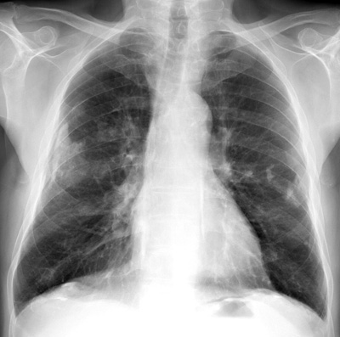
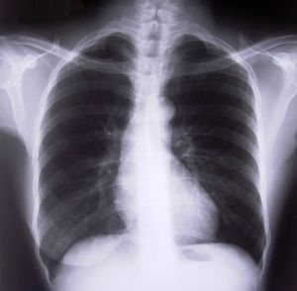
What can DUST do to me ?
Which of these people controlled their dust exposure?
Which of these is the oldest?
Notes:
The X-ray on the left is of healthy lungs – represented by the black spaces for the air spaces (alveoli) inside the lungs
The X-ray on the right is of lungs with Pneumoconiosis (such as asbestosis or silicosis). The white ‘wisps’ are indicative of the scarring and following calcification of the scar tissue inside the lungs.
The one the right could be said to have controlled their dust exposures. Its more difficult to say which is the oldest, however it would be reasonable to suggest that the one on the left is as the scarring is evidence of long term exposures to dust.
X-Rays are notoriously difficult to read, in this regards this slide should be used as a discussion point rather than as a slide with right and wrong answers

Slide 16
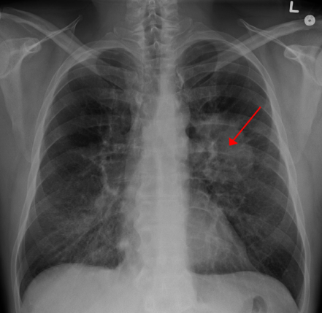
What can DUST do to me ?
Lung Cancer
Malignant tumour (uncontrolled cell growth) inside your lungs
The more dust inhaled, the more likely cancer will develop
  If a low amount of dust inhaled the risk of cancer occurring is low
"LungCACXR" by James Heilman, MD - Own work. Licensed under Creative Commons Attribution-Share Alike 3.0 via Wikimedia Commons
Notes:
Lung cancer is a cancer inside the lungs. With regards to the categories described previously this may be caused by wood or silica, however many chemicals in construction can cause cancer (such as diesel engine emissions)
With COPD and Silicosis the more dust you breathe the worse the disease will get, however with Lung Cancer it is a case of the more you breathe the greater the risk of developing the disease. Once you it develops it then grows and worsens of its own accord, independent of whether you continue to breathe in dusts or not.
An good analogy is that of smoking. Smoking increases the risk of getting lung cancer. One cigarette has a very small risk of causing cancer, however 20 a day significantly increases that risk.
Cancer can occur wherever the cancer causing dust gets trapped. For example with wood dust, this can also get trapped in the sinuses. Once trapped here it can cause paranasal sinus cancer (cancer in the sinus).

Slide 17
What can DUST do to me ?
What does all this do to me?
Typical symptoms of poor lung health are;
  Increased breathing rate
  Wheezing or crackling from lungs
  Shorter, shallower breaths
  Increased tiredness
  Inability to exercise for even short periods
Treatment is very difficult, and full cures are unlikely.
Regular or permanent use of oxygen cylinders is not uncommon to compensate for the reduced lung function
HOW WILL ALL OF THIS EFFECT YOUR HOME LIFE?
Notes:
Because dusts effect the respiratory system the early signs and symptoms of all of the diseases can be easily confused between the diseases. The list on the slide represents a good overview of the classic symptoms of lung damage to look out for.
It is important for individuals to identify the early symptoms so they are able to act upon any of them as soon as possible. Treatment for many symptoms is possible, however once many of the diseases develop then full recovery is unlikely.

Slide 18
The Construction Dust Partnership
What do exposures look like?
Notes:
Individuals need to know what a serious dust exposures look like. A single example is given in the following slide, that of sanding wood. This is done to show how lighting conditions can influence what dust can or cannot be seen.
Alternative examples of work specific to the audience can be inserted here should they be available.

Slide 19
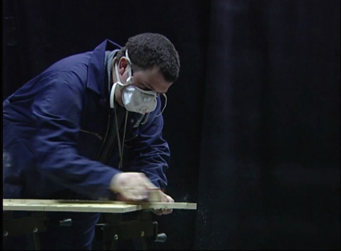
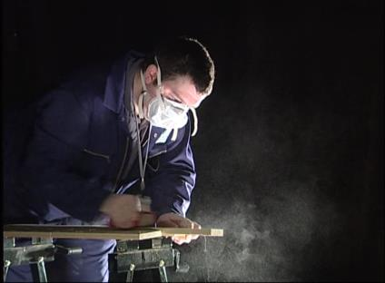
What do exposures look like ?
Picture taken under normal light
Picture taken under Tyndall lighting
Don’t let your eyes deceive you. The most hazardous dusts are those that you can’t see
Notes:
The most serious diseases that result from dust exposure are those that result in exposure to respirable dust. These dusts are not always visible to the naked eye and take particular lighting to become apparent.
Both of the photos are taken of the same process, the only difference being the lighting. Tyndall lighting is simply a light shining at 90 degree to the position of the viewer. A similar effect can be seen in a dark room, where a single beam of light comes through a crack in the curtains illuminating the suspended dusts in the air.

Slide 20
The Construction Dust Partnership
What can I do about it?
Notes:
Knowing what dusts are and what they can do to us is one part of the problem, the second is to act on them. The following slides have been written to provide some generally applicable information on the management of dusts.
The presenter should take the opportunity in this section to talk about the measures that are in place for their specific audience and why they must be used.

Slide 21
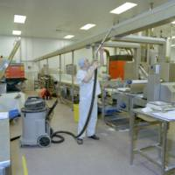

What can I do about it ?
Use the Controls you are provided
Engineering controls such as on tool-extraction systems and damping down will reduce your exposure. Use these in combination with a suitable P2 or P3 grade dust masks
Take individual responsibility for yourself and co-workers
  Ensure your work does not cause increased and uncontrolled dust
  Use M-Class filtering dust extraction units or damping down to prevent exposures to dusts
  Damp down dusts prior to sweeping or use M-Class filtering Dust Extraction Units to clean your workplace
  Remember that PPE such as dust masks will only protect yourself. Do others in your area have the same PPE
Notes:
There are a number of different means of control of dusts, many of which have been made at an early stage when the work has been originally planned. This slide summarises the requirements of any engineering control that may be in place, particularly with regards to the new requirement of dust extraction units.
On tool systems such as damping down or extraction are never 100% effective. Whist they capture much of the dust they should always be used in conjunction with other controls (namely dust masks). Dust control systems do not only protect yourself but the others around you and who follow on from you (such as cleaners). Most disease is caused by regular small exposures, not a single large one off exposure. So don’t fall into the trap of saying to yourself that “its only a quick one off job”, ask yourself how many times will you end up doing that quick job in a life time. Most lung diseases are a result of cumulative exposures over time, each exposure adds a little bit upon the last until over the years the disease actually manifests.
The new classification system for extraction and dust control systems is simply H, M and L. This equates to the hazard level of the dust that the filtering system can control; H for high hazard dusts, M for Medium and L for Low. All the dusts discussed in this presentation are classed as Medium hazard and so must be controlled using M-Class dust extraction systems.

Slide 22
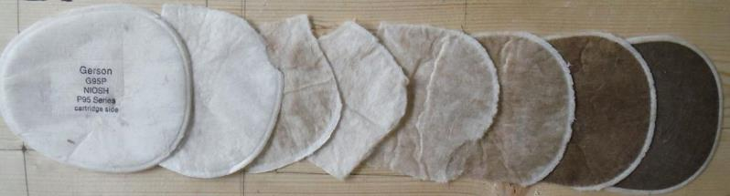
Use the masks that you are provided with
Check your RPE is either P2 or P3 standard and suitable for the dusts being raised.
Make sure it fits properly
  Face masks only work if you are clean shaven
  Tight fitting masks require a fit test prior to initial use, periodically and if your facial characteristics change – e.g. due to major weight changes
  Correctly fit the mask prior to use, cover the mask with your hands and inhale sharply - you should feel the mask suck onto your face if you have a good fit
"NIOSH P95 cross section". Via Wikipedia
Notes:
PPE is the last form of control against dusts, but quite often the one that is put in place as it is percieved to be cheaper and easier. PPE is the last form of defence as it is the last physical barrier between yourself and the dust that is in the air. For that reason it is important that individuals are aware of what they can do to make sure it is fit for them and the job they are doing.
The suitability of RPE is vital and people need to take some responsibility for what they use. For example, silica dust must be controlled using a P3 respirator. If they are provided a P2 respirator then they need to change it for another one.
Being clean shaven is an important aspect of a dust mask. Air will always follow the path of least resistance, and this needs to be through the filters of the RPE. With a beard or stubble this lifts the mask from the skin, providing a path for contaminated air to bypass the filters and get into the respiratory system.
Face fit testing is a requirement for all close fitting respiratory protection. Any RPE that requires a tight seal against the face needs to be formally checked that it is going to the job properly. An analogy can be made with another form of PPE – fall arrest harnesses. Is it not reasonable to ensure that an individuals weight is within the capabilities of the harness they are to wear? The same principle applies.
Face fit testing is a one off test that needs to be performed, but users need to check they are wearing their mask correctly every time they put one on. Face fit testing helps as they will be accustomed to how it feels to have a mask fitted properly. Once put on, if a user covers the mask with their hands and breathes in sharply then they should feel the mask suck onto their face. This tests whether there is adequate seal between the face and the mask. It is advisable to repeat this twice, once through the nose and once through the mouth. This ensures that the seal is complete over the bridge of the nose as well.
A common complaint is that masks cause safety glasses to steam up. Should this happen it is indicative that the mask is not fitted properly. Tighten the straps (if possible) and check fitting across the bridge of the nose to fix this. Should it continue then an alternative mask needs to be sought.
The picture is an indicator or the structure of a mask and how it has been designed to capture dusts. The multiple filters use a combination of techniques (physical entrapment, aerodynamics and static charge) to ensure all particles are removed from the air that a person breathes in.

Slide 23
The Construction Dust Partnership
In summary
Dusts have the potential to cause serious long term ill health
They remain the 2nd biggest killer in the construction industry
You may be damaging yourself without realising it
The majority of diseases cannot be treated – you will have them for life
You can take control of your health and others around you. Do not create dust, use dust suppression methods, use your mask correctly
Notes:
This slide summarises the whole presentation. It should be reiterated that dusts are a re serious problem in the construction industry and have the potential to kill.
The reason for this predominantly lies in the fact that the ill health takes many years to manifest so companies and individuals have been reluctant to put in the extra time and effort to control them as they need to be. The change happening in the industry with regards to the management and control of dusts comes predominantly from awareness, such as this training. It is important therefore to take the message on board and act now to protect yourself.

Slide 24
The Construction Dust Partnership
Any Questions?

